Slide 1
Big Data Platforms Final Project: Will TuringBots replace human software developers?
Big Data and Cloud Computing
Hritik Jhaveri

Slide 2
Executive Summary
This analysis provides key insights into trends in GitHub repositories, programming language usage, and the evolving role of AI in software development. The findings highlight the increasing impact of automation, the dominance of specific programming languages in AI/ML, and the role of major tech companies in driving open-source innovation.
Key Findings
AI-Assisted Development Growth: The rise of AI-powered tools, such as TuringBots, has led to a noticeable increase in automated commits, signaling a shift towards AI-assisted coding.
Programming Language Trends: Python continues to lead AI/ML development, while JavaScript remains highly active in web technologies. The declining presence of C and C++ in AI suggests a transition toward higher-level languages for efficiency.
Automation vs. Human Contribution: While AI can handle repetitive tasks and optimize workflows, human developers remain critical for architectural decisions, debugging, and innovative problem-solving.
Enterprise and Open-Source Collaboration: Large-scale contributions from industry leaders like Google and Linux demonstrate that corporate-backed open-source projects significantly influence AI and software development.
Patterns in Code Contributions: Many commits, especially in front-end technologies, are repetitive or automated, highlighting the growing reliance on pre-built templates and frameworks.

Slide 3
Methodology and source data overview
Data Overview
Source: Data sourced from GitHub Archive, hosted on Google Cloud Storage, totaling approximately 1.36 TiB.
Contents:
Historical commit records (author details, timestamps, messages).
Repository-level programming language usage.
License information for repositories.
Metadata about files (e.g., paths, permissions).
Actual file contents.
Dataset Composition
Commit Data: Contains metadata such as committer names, commit dates, and associated messages.
Language Data: Tracks the programming languages used in repositories.
License Data: Records the types of licenses applied to repositories.
File Metadata: Includes details like file paths and access modes.
File Contents: Stores the textual or binary content of files.
Data Preparation
Cleaning: Eliminated duplicate records to ensure data uniqueness; Removed irrelevant or incomplete entries.
Handling Missing Values: Addressed null or incomplete data points systematically.
Text Processing: Standardized and cleaned textual data, such as commit messages, for consistency.
Analytical Methodology
Exploratory Data Analysis (EDA): Investigated the distribution and relationships of key variables. Uncovered trends and patterns within the dataset.
Temporal Analysis: Examined commit activity over time to identify trends and anomalies.
Textual Analysis: Assessed the similarity of commit messages to detect duplication or redundancy.
Technologies Utilized
Data Processing: Apache Spark for data manipulation and data processing.
Visualization: Python libraries Matplotlib and Pandas for visual representations.

Slide 4
Data Preprocessing and Cleaning
Function Development
These functions were developed to streamline data quality checks and ensure thorough preprocessing of the dataset.
null_count: Designed to identify and check for null or missing values in the dataset.
show_duplicates: Created to calculate and report the percentage of missing values for each column.
Languages
The dataset contained nested columns, from which the relevant fields repo_name, language_name, and bytes were extracted.
The sampled data was clean, with no missing or duplicate values.
Commits
The dataset contained nested columns, from which the following relevant fields were extracted: commit, tree, parent, author_name, author_email, author_time, committer_name, committer_email, committer_time, subject, message, repo_name.
The sampled data was clean, with no missing or duplicate values.

Slide 5
Data Preprocessing and Cleaning
Languages
The dataset contained nested columns, from which the relevant fields repo_name, language_name, and bytes were extracted.
The sampled data was clean, with no missing or duplicate values.
Licenses
The dataset was flat (non-nested) and required no additional preprocessing.
The sampled data was complete, with no missing or duplicate values.
Contents
The dataset was flat (non-nested) and had minimal duplicate values.
However, the content column contained missing values, which were removed during preprocessing.
Files
The dataset was flat (non-nested) but included a poorly populated column, symlink_target, with over 99% missing values. This column was dropped.
No duplicate values were present in the sampled data.

Slide 6
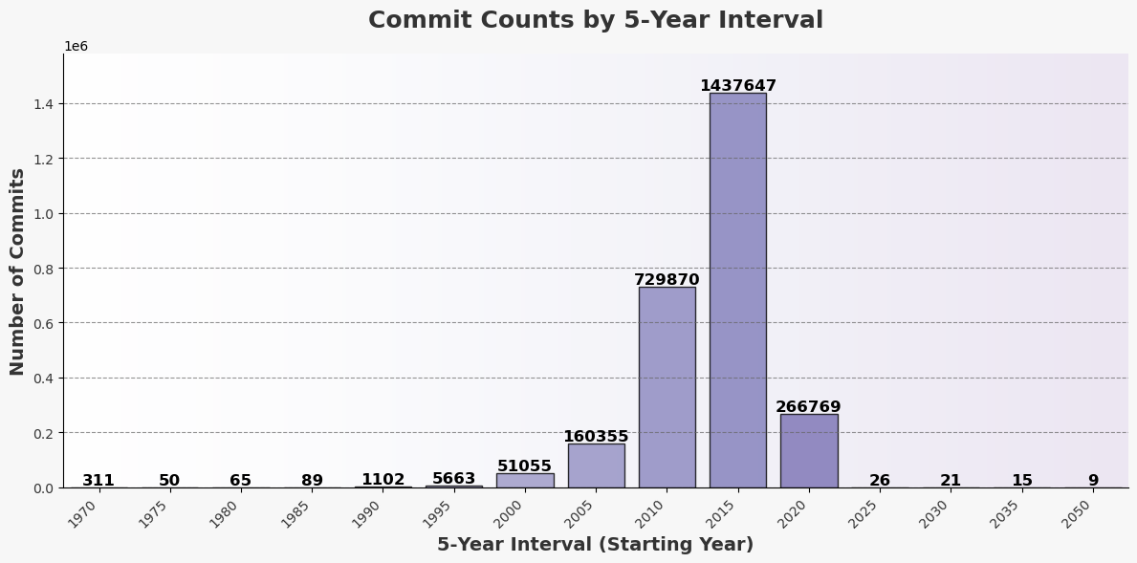
EDA – Author Analysis

Slide 7
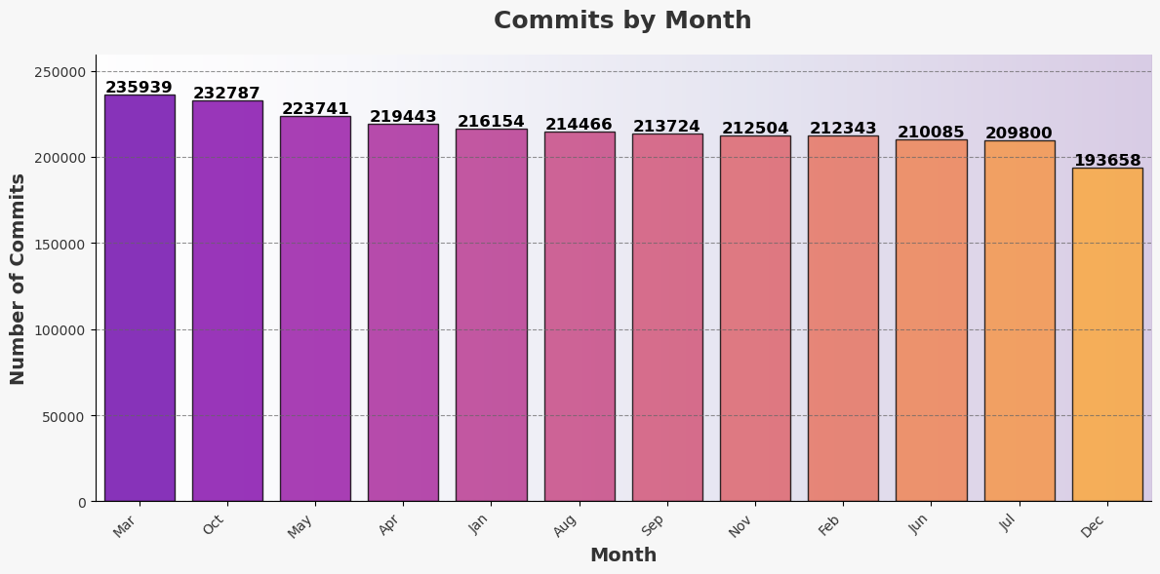
EDA – Author Analysis

Slide 8
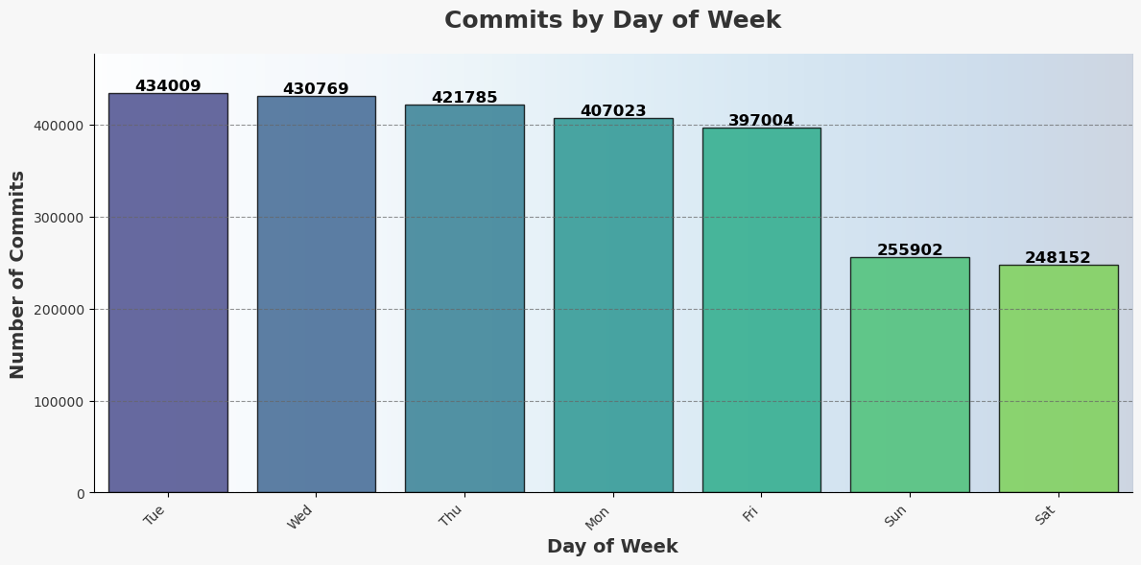
EDA – Author Analysis

Slide 9
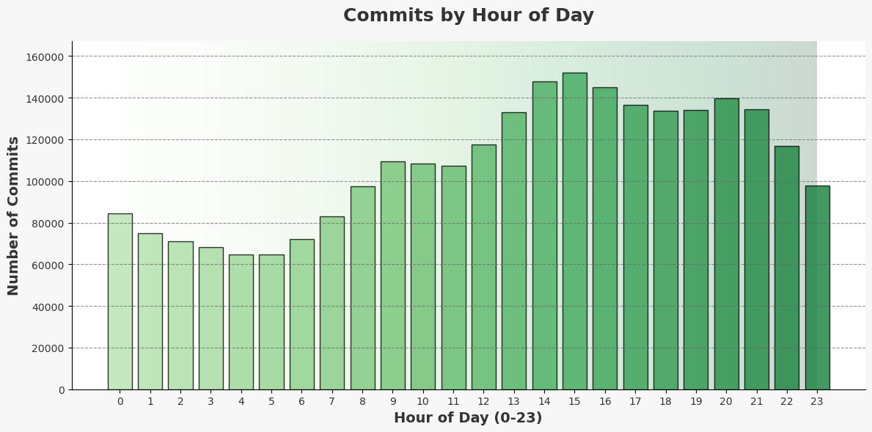
EDA – Author Analysis

Slide 10
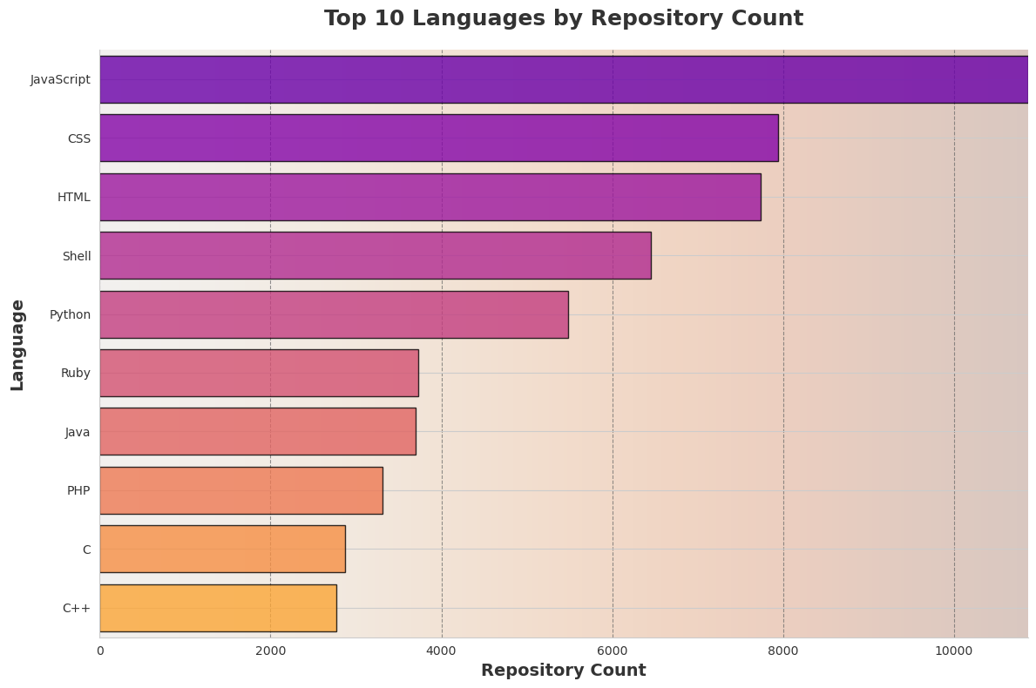
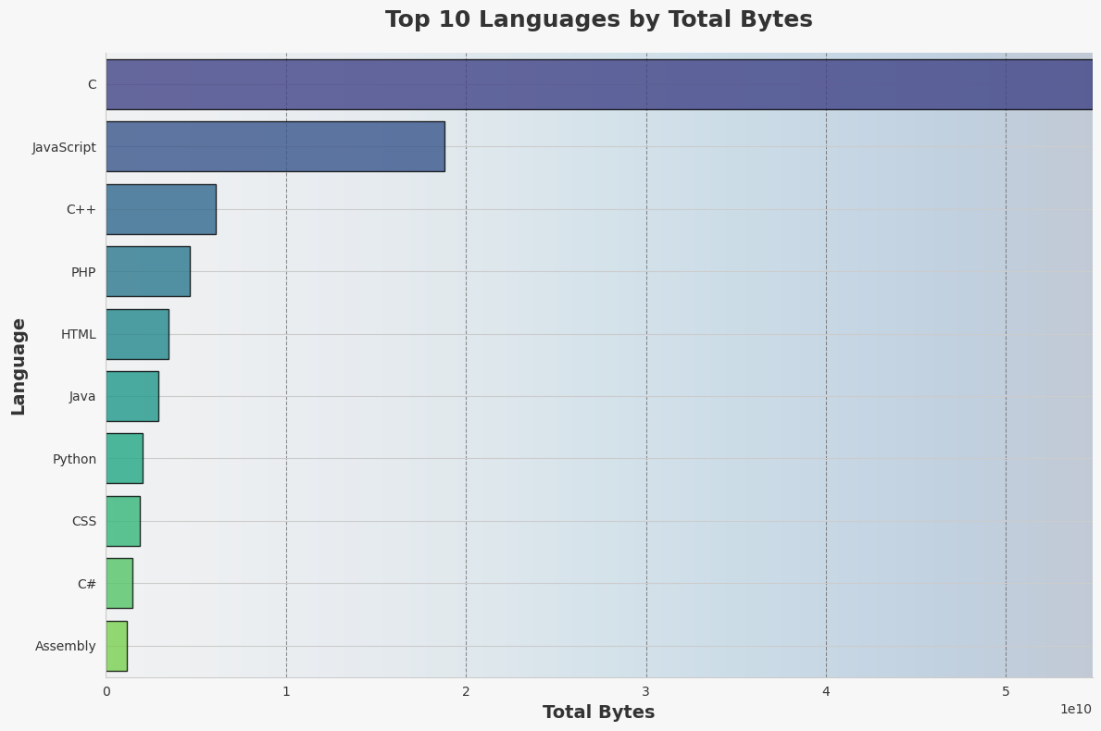
What are the most popular programming languages on GitHub?
The most common language by total bytes is C and by repository is JavaScript.
Overall, JavaScript is the most popular language showing its versatility across projects.

Slide 11
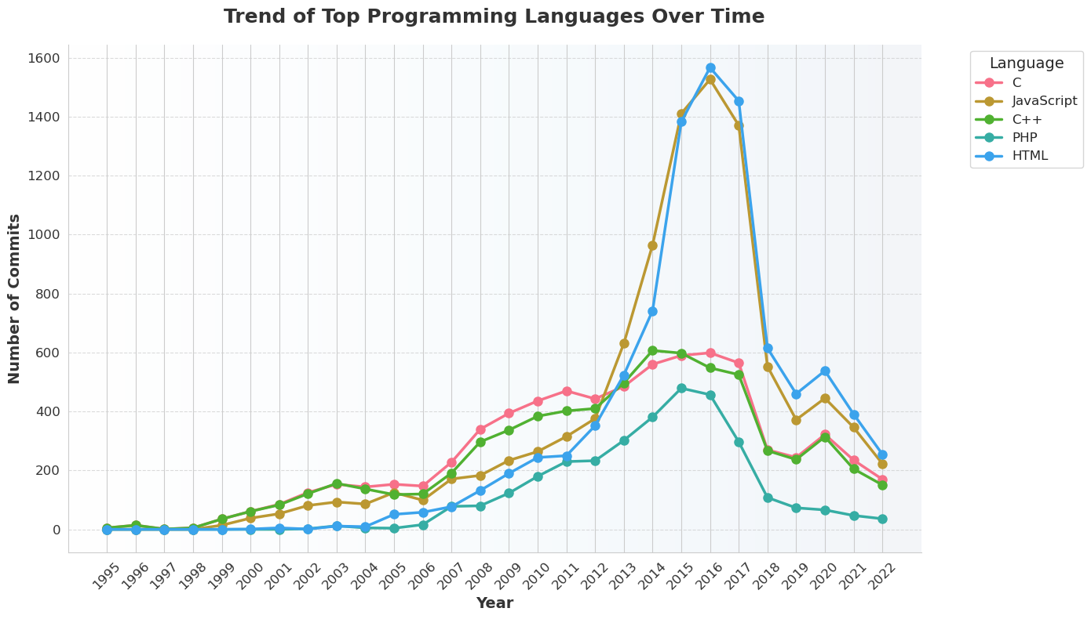
Did the trend of most popular programming languages change over time?
Yes, the trend of most popular programming languages has change over time.
An up trend in the number of languages is observable in the mid to late 2000’s, which could be attributed to the introduction Git and GitHub.
Another giant spike is observed in the mid 2010s for JavaScript and HTML which could be attributed to the introduction of cloud-based services and mobile web development.

Slide 12
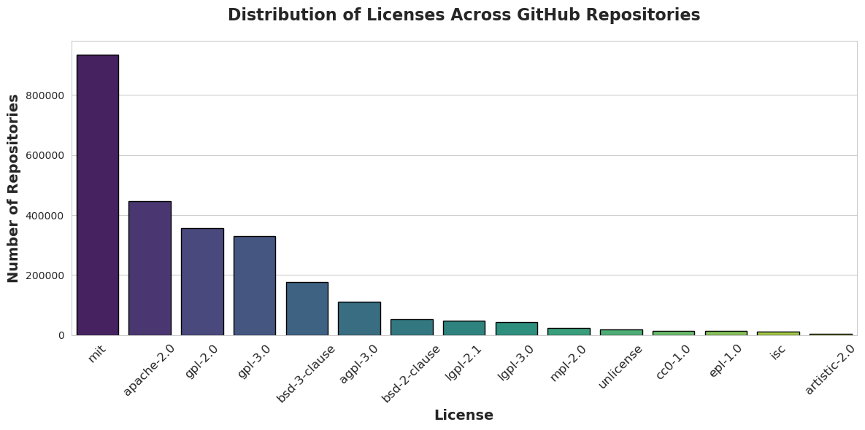
What is the distribution of licenses across GitHub repositories?
The MIT license has the most repositories.
The next 3 licenses apache 2.0, gpt 2.0 and gpl 3.0 have similar number of repositories.
This can be attributed to the widespread adoption of open-source preference in the programming ecosystem which promotes collaboration and reuse.

Slide 13
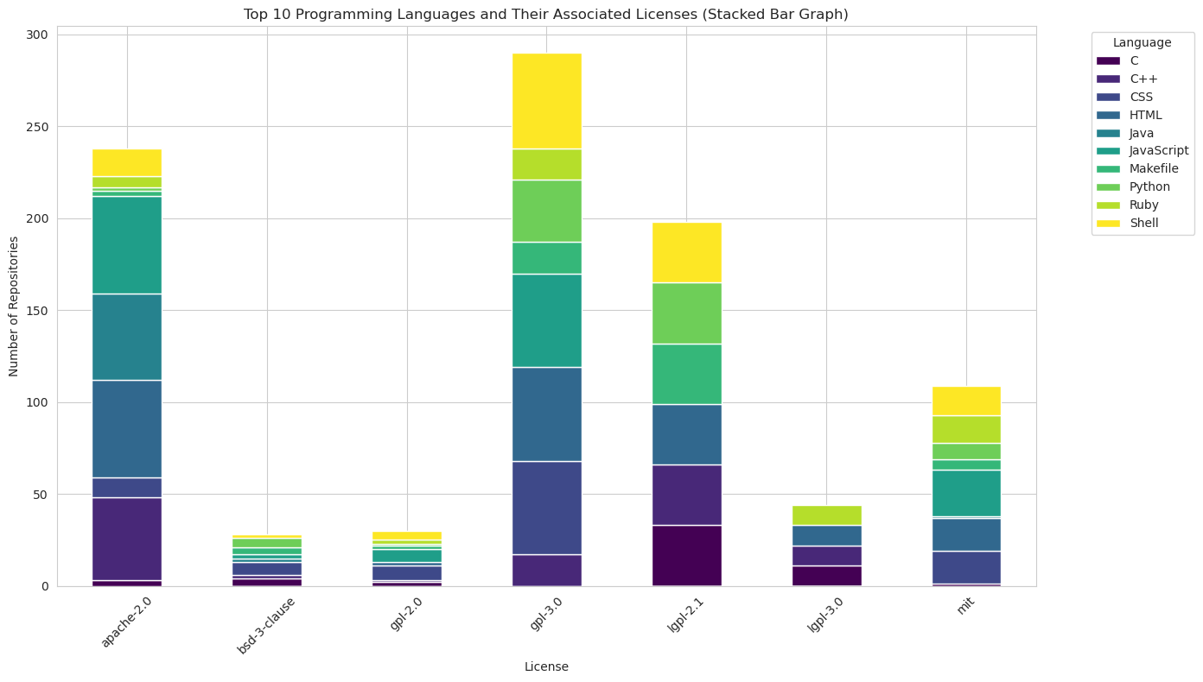
Any certain programming languages that are more likely to be associated with a particular license?
GPL-3.0 has the most diverse language usage, with many programming languages contributing to repositories under this license.
C and C++ are more prominent in GPL-based licenses, which suggests strong adoption in open-source projects.
Python, JavaScript, and Ruby appear to be among the most used languages across multiple licenses.

Slide 14
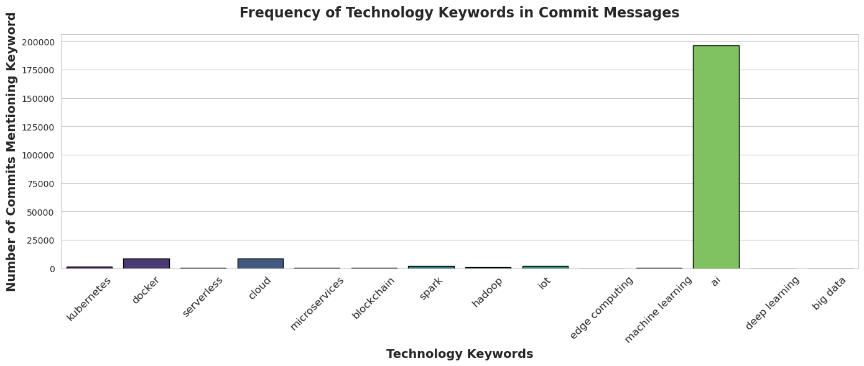
What can you tell about the most popular and most rapidly growing repositories?
Is there certain technology that is driving popularity or explosive growth?
The keyword with the most mentions in ‘ai’.
As visible from the graph, no other keyword even crosses 10,000 mentions whereas AI has close to 200,000 mentions.
This is due to the recent increase in interest in AI and AI based technologies.

Slide 15
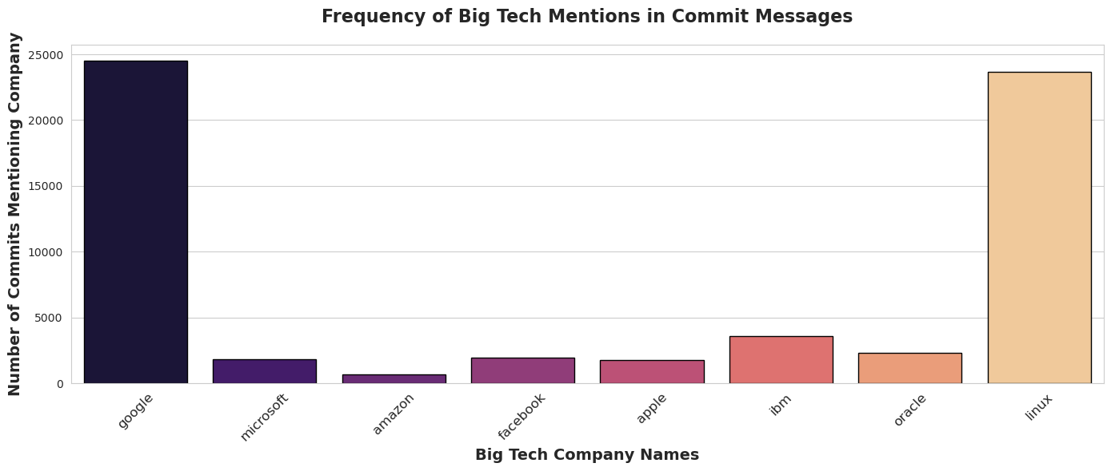
What can you tell about the most popular and most rapidly growing repositories?
Are these associated with Big Tech, who are open sourcing the technology?
The keywords ‘google’ and ‘linux’ have the most mentions.
The high number of mentions for Google and Linux underscores their extensive influence and contributions to the software development community.
The mention of Linux also emphasizes its foundational role in many open- source environment and developmental projects.

Slide 16
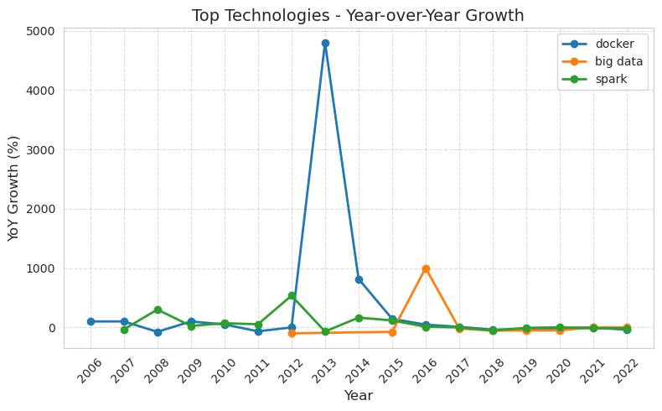
What can you tell about the most popular and most rapidly growing repositories?
Are there any technological breakthroughs that are driving this brisk adoption?
The top 3 tech keywords were ‘docker’, ‘big data’ and ‘spark’
There is a significant spike in the YoY growth in the ‘docker’ in 2013 because the Docker application was first released in 2013.
The spike in ‘spark’ is because the Apache Software Foundation accepted Spark as an incubator project marking the beginning of Spark's rapid growth and adoption within the big data community.

Slide 17
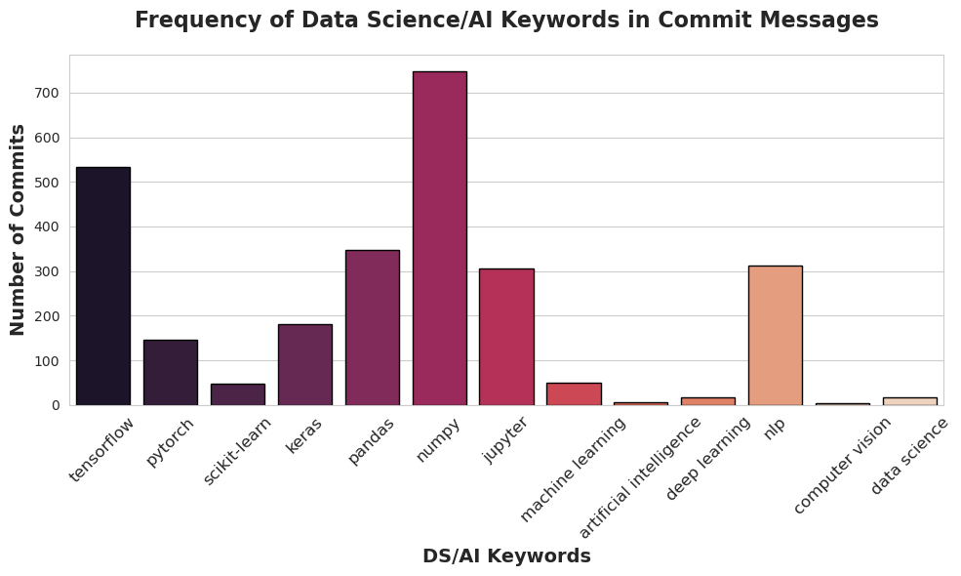
Identify what technologies are most frequently associated with Data Science or AI projects
The keyword with the most commits in ‘numpy’, followed by ‘tensorflow’ and ‘pandas’.
All of the them are python libraries which shows the heavy reliance on them for DA/AI related projects

Slide 18
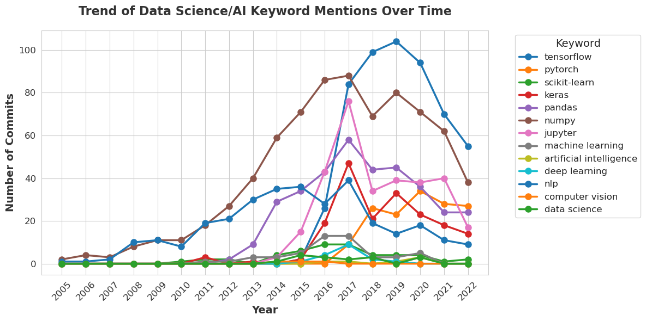
Identify what technologies are most frequently associated with Data Science or AI projects changed over time
The keyword with the highest commits in a single year in ‘tensorflow’ which is a machine learning python library.
This shows the heavy reliance of machine learning on DS/AI related projects.
The trend analysis shows that there is an uptrend in most of the keywords, implying increase in the number of DS/AI replated projects.

Slide 19
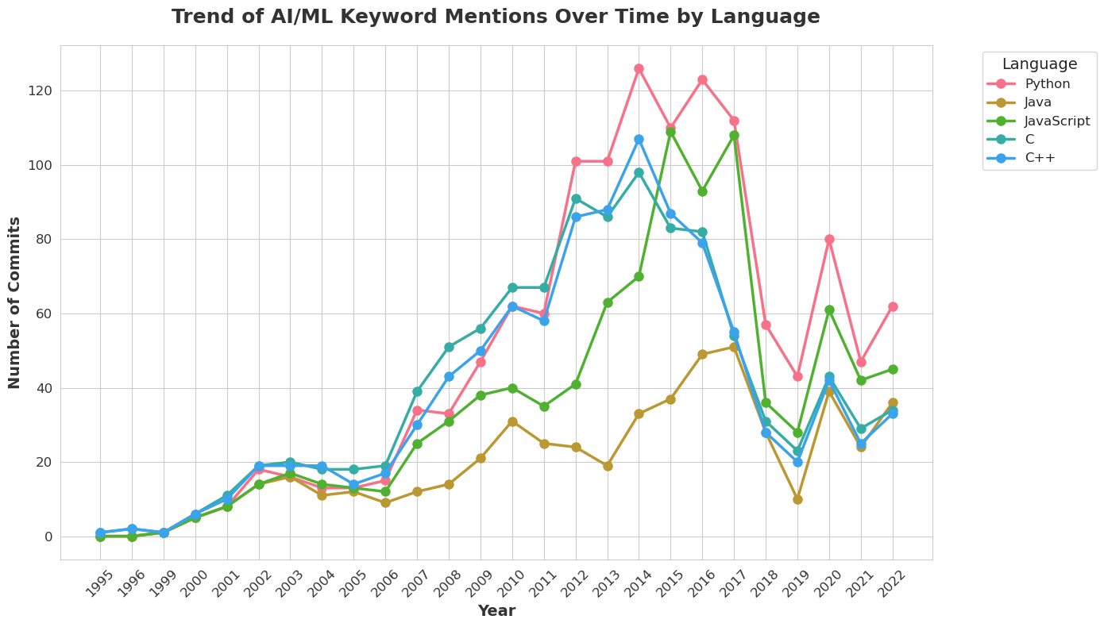
Identify what technologies are most frequently associated with Data Science or AI projects changed over time
Python dominates AI/ML development, as expected, due to libraries like TensorFlow, PyTorch, and scikit-learn.
C and C++ had strong AI/ML involvement in earlier years, likely due to foundational ML frameworks and performance-critical implementations.
The decline in mentions post-2017 could suggest a shift to dedicated AI platforms rather than frequent AI-related commit messages.

Slide 20
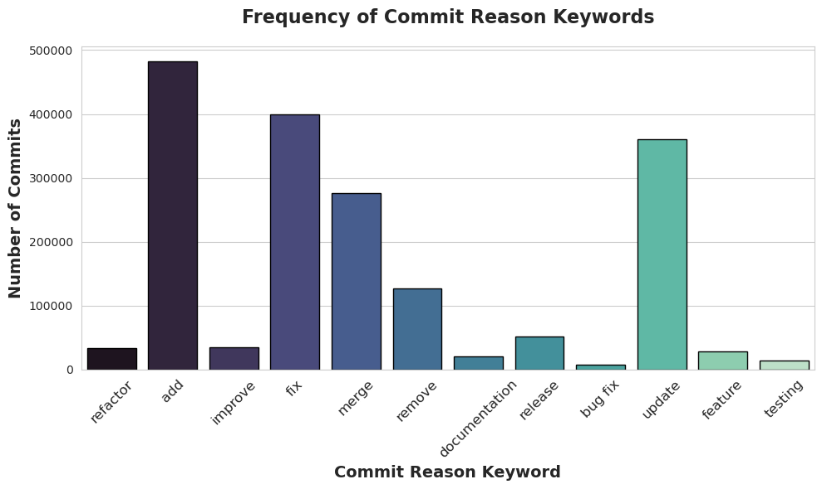
What are the most frequent reasons for committing into GitHub repositories?
Based on the keywords the most frequent reason to commit into repositories is to ‘add’, indicating commits where new features, files, or code segments are added to the project
Keywords like ‘merge’ and ‘release’ reflect common practices in collaborative development and version control.

Slide 21
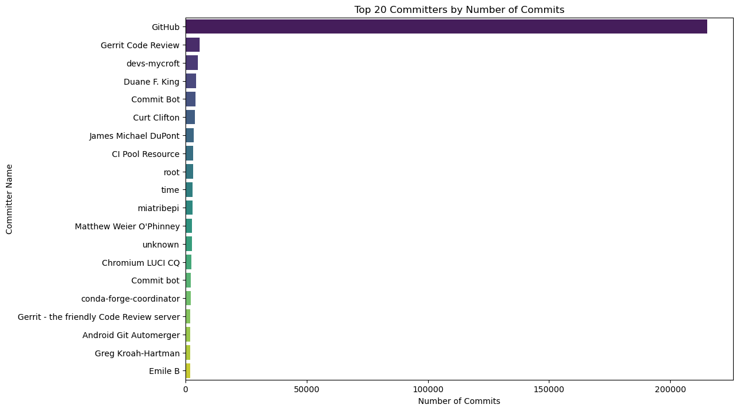
Identify the most prolific / influential Committers
By commit volume and visualize the distribution of these commits
The top committer by a very significant margin is GitHub, likely representing automated or aggregated commits from the GitHub platform itself.
A significant portion of the top committers are bots or automated systems (e.g., GitHub, Gerrit, Commit Bot, CI Pool Resource). This highlights the increasing reliance on automation in modern software development for tasks like CI/CD, code reviews, and merges.

Slide 22
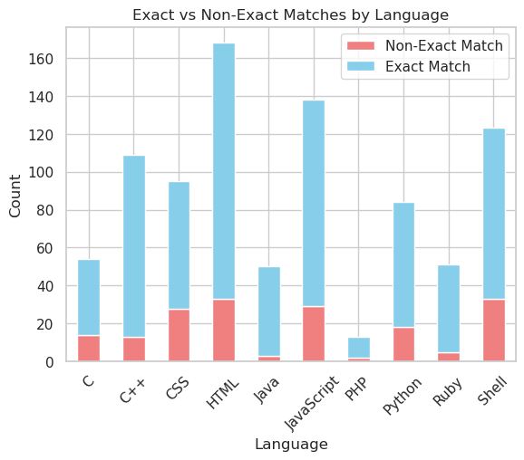
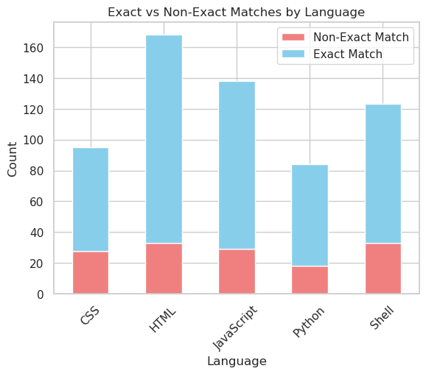
How unique are the “subject” and “message” values?

Slide 23
Are they mostly unique? Or are people usually just copy-pasting the same text?
We can see that Exact Matches (light blue) significantly outnumber Non-Exact Matches (light red) across all languages. This suggests that a large portion of the text is being copy-pasted rather than being uniquely written.
However, the presence of Non-Exact Matches in every language category indicates that some variation exists, meaning people are not always using identical text, but there is still a strong tendency toward repetition.
HTML and JavaScript have the most exact matches, suggesting these languages are more frequently used in ways that allow precise identification. CSS and Shell have a relatively higher proportion of non-exact matches, indicating possible variations in usage. Python has the lowest total count, suggesting it may not be as frequently matched as the others in this dataset.

Slide 24
Conclusions and actionable recommendations
While TuringBots (AI-driven coding assistants) are becoming increasingly powerful, they are unlikely to fully replace human software developers. Instead, they will augment human capabilities by automating repetitive coding tasks, improving efficiency, and reducing errors.
AI in Software Development
AI-driven development tools, known as "TuringBots," are becoming increasingly popular for coding assistance and automation.
The rise in AI-related commits and automated contributions on platforms like GitHub indicates a shift towards AI-assisted development​.
Programming Language Trends
Python remains the dominant language for AI and ML due to its extensive libraries and frameworks.
While C and C++ were historically significant in AI, their usage has declined post-2017 in favor of higher-level languages​.

Slide 25
Conclusions and actionable recommendations
Automation in Development
The most active committers on GitHub are automated bots, including CI/CD pipelines, reflecting the growing reliance on automation​.
A significant portion of commits, especially in JavaScript and HTML, appear to be repetitive or templated, suggesting frequent copy-pasting and automation​.
Big Tech Influence
Companies like Google and Linux remain at the forefront of open-source contributions, driving innovation in AI-assisted coding​.
Future of TuringBots
AI-powered tools are enhancing development efficiency but are not yet capable of fully replacing human software engineers.
Developers still play a crucial role in problem-solving, system architecture, and complex decision-making​

Slide 26
Conclusions and actionable recommendations
Actionable Insights:
Adopt AI-assisted coding tools to improve efficiency, especially for repetitive coding tasks.
Invest in upskilling developers to work alongside AI tools, focusing on problem-solving and design over basic coding.
Monitor automation trends to stay updated on which tasks can be delegated to AI without compromising software quality.
Leverage Python for AI development, given its growing dominance in ML and automation frameworks.
Encourage contributions to open-source AI projects, as major advancements are being driven by big tech and community collaborations.
Final Verdict: TuringBots will not replace human developers but will transform the role of software engineers. The future will be about collaboration between AI and humans, with AI handling routine tasks while humans drive innovation and decision-making.

